Slide 1
Diagnostics
Architekture of the .NET technology
Jan Janoušek, FEI - Katedra Informatiky

Slide 2
Microsoft Windows Events ^{EN}
Enables record specific application states
Exceptions, unexpected behavior, etc..
Provides, to the user, basic capability to check application state.
Requires administrator rights!
System.Diagnostics ^{Namespace}
EventLog
EventLogEntry
EventLogEntryCollection
EventLogPermission

Slide 3
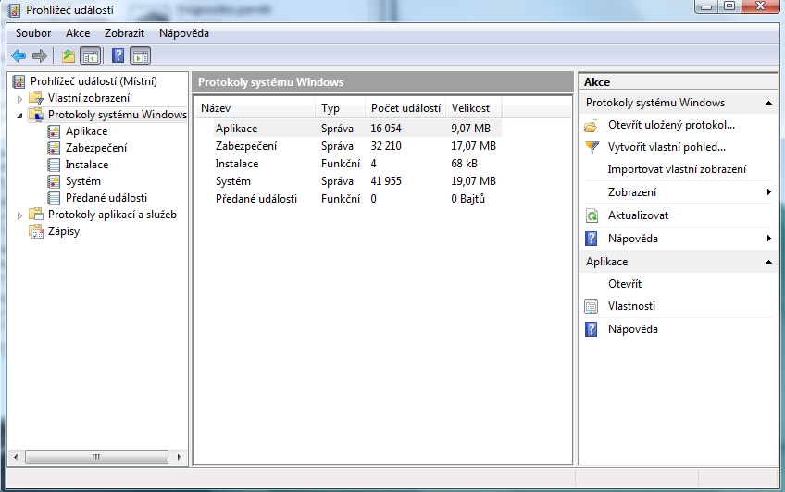
Microsoft Windows Events

Slide 4
Create and delete event log
class Program
{
...
void Creating()
{
EventLog myTest = new EventLog("MyTest");
myTest.Source = "MyTestSource";
myTest.WriteEntry("Testing - warning", EventLogEntryType.Warning);
}
void Deleting()
{
EventLog.Delete("MyTest");
}
}

Slide 5
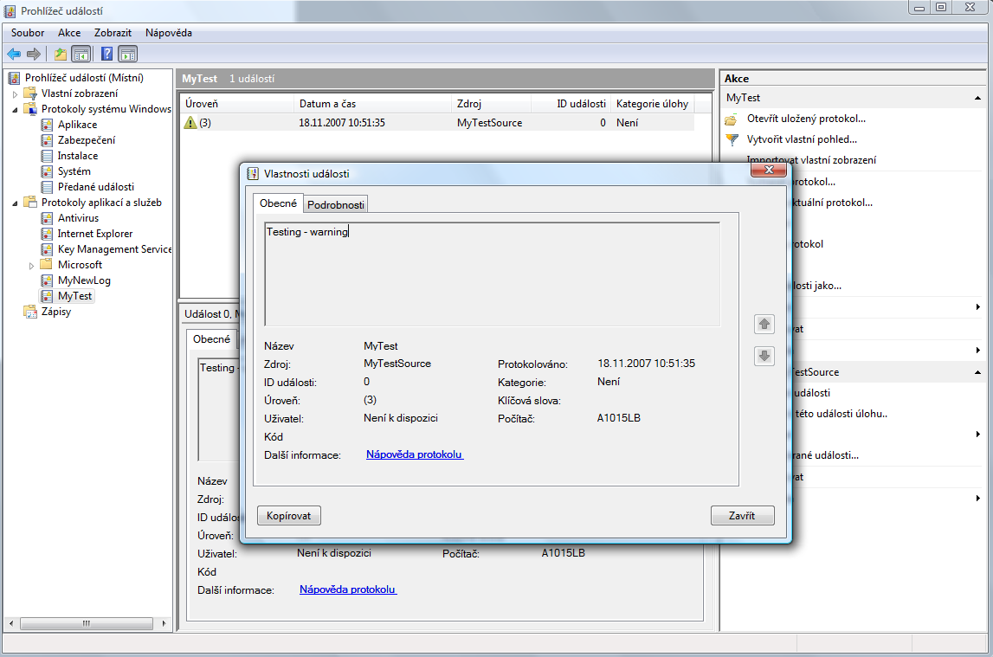
Create and delete event log

Slide 6
Write
EventLog myTest = new EventLog("MyTest");
myTest.Source = "MyTestSource";
myTest.WriteEntry("Testing - information", EventLogEntryType.Information);
myTest = new EventLog("MyTest");
myTest.Source = "MyTestSource 2";
myTest.WriteEntry("Testing - information", EventLogEntryType.Information);
myTest = new EventLog("Application");
myTest.Source = "MyTestSource SS";
myTest.WriteEntry("Testing - information", EventLogEntryType.Information, 100);

Slide 7
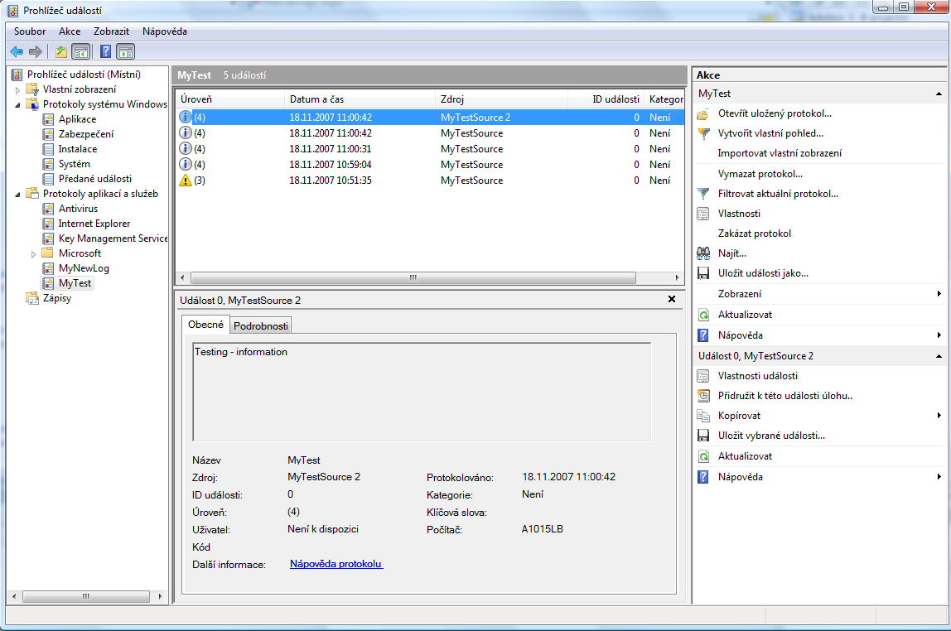
Write

Slide 8
Read and delete
EventLog myLog = new EventLog();
myLog.Log = "MyTest";
foreach (EventLogEntry entry in myLog.Entries)
{
Console.WriteLine("\tEntry: " + entry.Message);
}
EventLog myLog = new EventLog();
myLog.Log = "MyTest";
myLog.Clear();

Slide 9
Diagnostics
System.Diagnostics ^{Namespace}
Debugger
Debug
Provides informations about the application (fot the developer) – similar to debugging in VS, but no special software is required.
Works only in the Debug mode. Ignored in Release mode.

Slide 10
Debugger
Methods
Break
IsAttached
IsLogging
Launch
Log

Slide 11
Debugger
Break
Log
for (int i = 0; i < 100; i++)
{
if (i == 50)
{
Debugger.Break();
}
}
for (int i = 0; i < 100; i++)
{
if (i == 60)
{
Debugger.Log(1, "Test", „Testing…");
}
}

Slide 12
Debug
Methods
Assert
Close
Fail
Flush
Indent
Print
unindent
Write
WriteIf
WriteLine
WriteLineIf

Slide 13
Debug
Assert
<?xml version="1.0" encoding="utf-8" ?>
<configuration>
<system.diagnostics>
<assert assertuienabled="true" logfilename="d:\\myFile.log" />
</system.diagnostics>
</configuration>
int index;
index = 10;
Debug.Assert(index > -1);
index = -10;
Debug.Assert(index > -1);

Slide 14
Debugging attributes
DebuggerBrowsableAttribute
DebuggerDisplayAttribute
DebuggerHiddenAttribute
DebuggerNonuserCodeAttribute
DebuggerStepperBoundaryAttribute
DebuggerStepThroughAttribute
DebuggerTypeProxyAttribute
DebuggerVisualizerAttribute

Slide 15
Trace
Properties
AutoFlush
IndentLevel
IndentSize
Listeners
UseGlobalLock
Methods
Close
Fail
Flush
Indent

Slide 16
Trace
Methods
Refresh
TraceInformation
TraceWarning
Unindent
Write
WriteIf
WriteLine
WriteLineIf

Slide 17
Related classes
TraceSource
TraceSwitch
DefaultTraceListener
TextWriterTraceListener
XmlWriteTraceListener
EventLogTraceListener
DelimitedListTraceListener

Slide 18
TraceSwitch
<configuration>
<system.diagnostics>
<switches>
<add name="mySwitch" value="1" />
</switches>
</system.diagnostics>
</configuration>
private static TraceSwitch appSwitch = new TraceSwitch("mySwitch", "Switch ...");
public static void Main(string[] args)
{
Console.WriteLine("Trace switch {0} configurable as {1}",
appSwitch.DisplayName, appSwitch.Level.ToString());
if (appSwitch.TraceError)
{
//...
}
}

Slide 19
TextWriterTraceListener
static void Main(string[] args)
{
Stream myFile = File.Create("TestFile.txt");
TextWriterTraceListener myTextListener = new TextWriterTraceListener(myFile);
Trace.Listeners.Add(myTextListener);
Trace.Write("Test output ");
Trace.Flush();
}

Slide 20
TextWriterTraceListener
<configuration>
<system.diagnostics>
<trace autoflush="false" indentsize="4">
<listeners>
<add name="myListener" type="System.Diagnostics.TextWriterTraceListener" initializeData="Output.log" />
<remove name="Default" />
</listeners>
</trace>
</system.diagnostics>
</configuration>
static void Main(string[] args)
{
Trace.Write("Test output ");
Trace.Flush();
}

Slide 21
XmlWriteTraceListener
<configuration>
<system.diagnostics>
<trace autoflush="false" indentsize="4">
<listeners>
<add name="xmlListener"
type="System.Diagnostics.XmlWriterTraceListener"
initializeData="xmlOutput.xml"
traceOutputOptions="ProcessId, DateTime" />
<remove name="Default" />
</listeners>
</trace>
</system.diagnostics>
</configuration>

